Slide 1
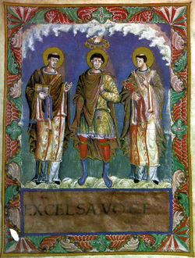
Democracy and the Middle Ages
Topics
Democracy and The 4 R’s
Greek Contribution to Democracy
Roman Contribution
Judeo-Christian Contribution
The Crusades
The Middle Ages
Power of the Catholic Church
100 Years War

Slide 2
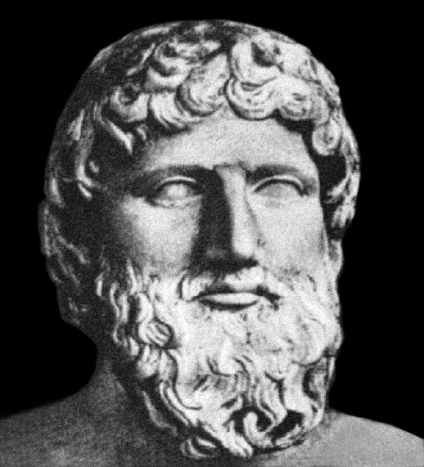
The Rise of Democratic Ideas
What is a Democracy?
It’s a system of government where the people have freedom of political choice
Created by the Ancient Greeks
Plato
What are other forms of
government?
The 4 R’s
Representative Government
Rule by Law
Individual Rights
Reason

Slide 3
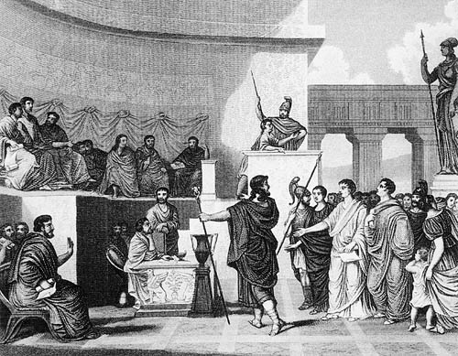
The Rise of Democratic Ideas
Representative Government
Modern democracies are not true democracies
Today we elect officials to work in our government
This is known as Representative Democracy
Elected officials represent the people

Slide 4
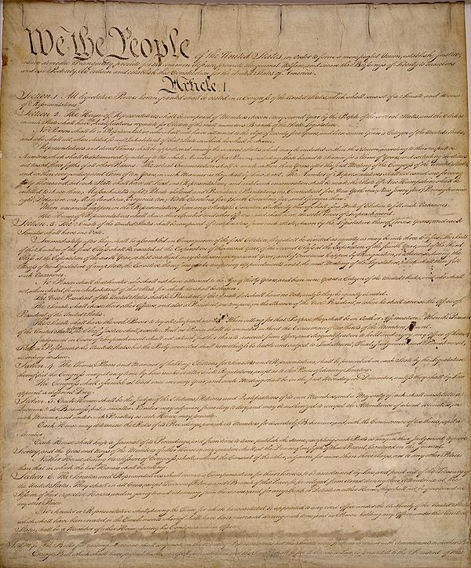
The Rise of Democratic Ideas
Rule by Law
No person is above the law in a democracy
Most democracies have written constitutions
Laws can be changed by a majority vote
Unjust laws can be challenged
Martin Luther King Jr.

Slide 5
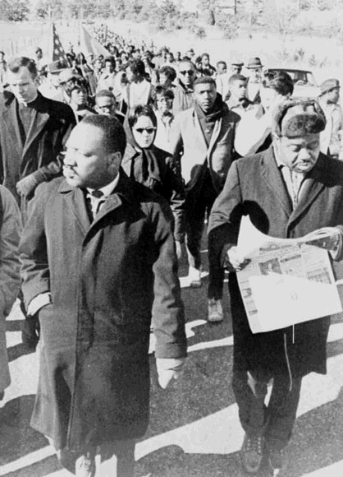
The Rise of Democratic Ideas
Individual Rights
Every person (rich or poor) has the same individual rights in a democracy
Elected government is expected to protect the people’s civil rights
Civil Liberties are the protections that the law gives to people’s freedom of thought and action
Civil Liberties include freedom of speech, freedom of press and freedom of religion

Slide 6
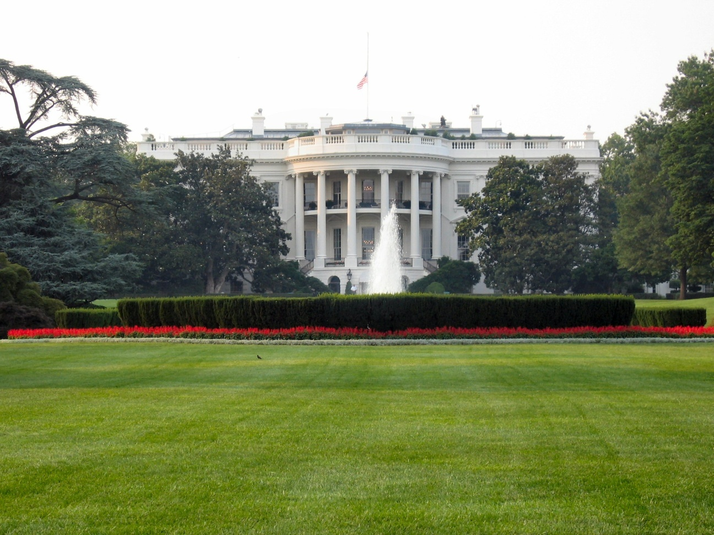
The Rise of Democratic Ideas
Reason
Democracies base their decisions on reasoned argument rather than on traditions that defy logic
Many debate whether or not the common people are capable of conducting a democracy

Slide 7
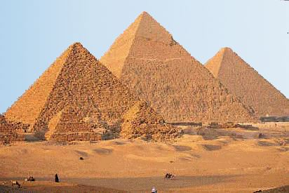
The Ancient Roots of Democracy
First organized governments were created 500o years ago
Early peoples needed a way to organize large-scale building projects
First organized governments were established in Mesopotamia, Egypt, India and China
They were ruled by monarchs, kings and pharaohs

Slide 8
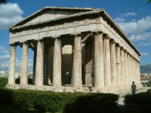
The Ancient Roots of Democracy
2,500 years ago the first democratic government took shape in Greece
Democracy means – Rule by the people
Greek Democracy
Rational thought, citizenship and political freedom established
Roman Democracy
Created Law

Slide 9
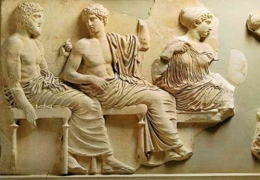
Athenian Democracy
Athens had a pure democracy
All adult males were part of the legislature
They met 40 times a year to decide public issues
They declared war, signed treaties, and spent tax money
The poorest person had the same vote as the richest person
Athens has been described as a government of amateurs

Slide 10
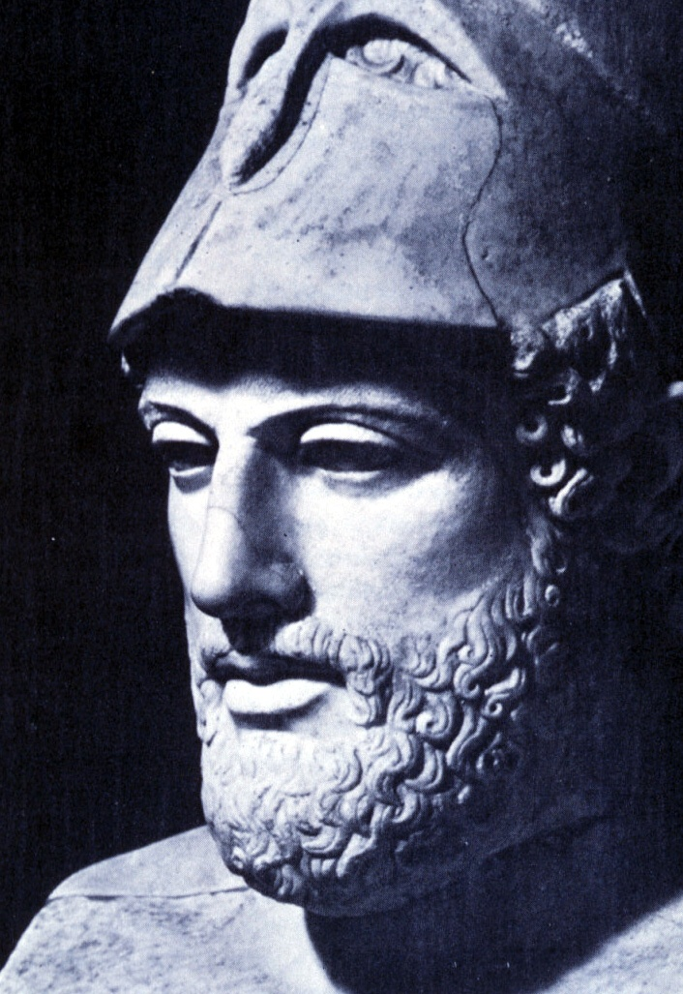
Athenian Democracy
Greeks demanded that all adult males participated in the democratic process
“We do not say that a man who takes no interest in politics is a man who minds his own business, we say that he has no business here at all”
-Greek Statesman Pericles
Notes:
Does everyone vote today? Not even close…it’s usually around 30% of the population
What does the quote mean? If you do not vote you have no business being a citizen

Slide 11
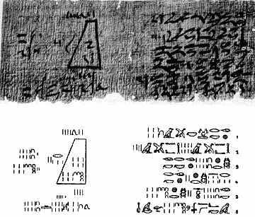
The Role of Reason
The Greeks were the first people to make scientific investigations and studies of human culture
Before the Greeks everything was interpreted by myths
Greeks invented natural law
The rules of nature could be discovered by human beings through careful observation and reasoned inquiry
Greeks made great advancements in science, literature, and politics

Slide 12
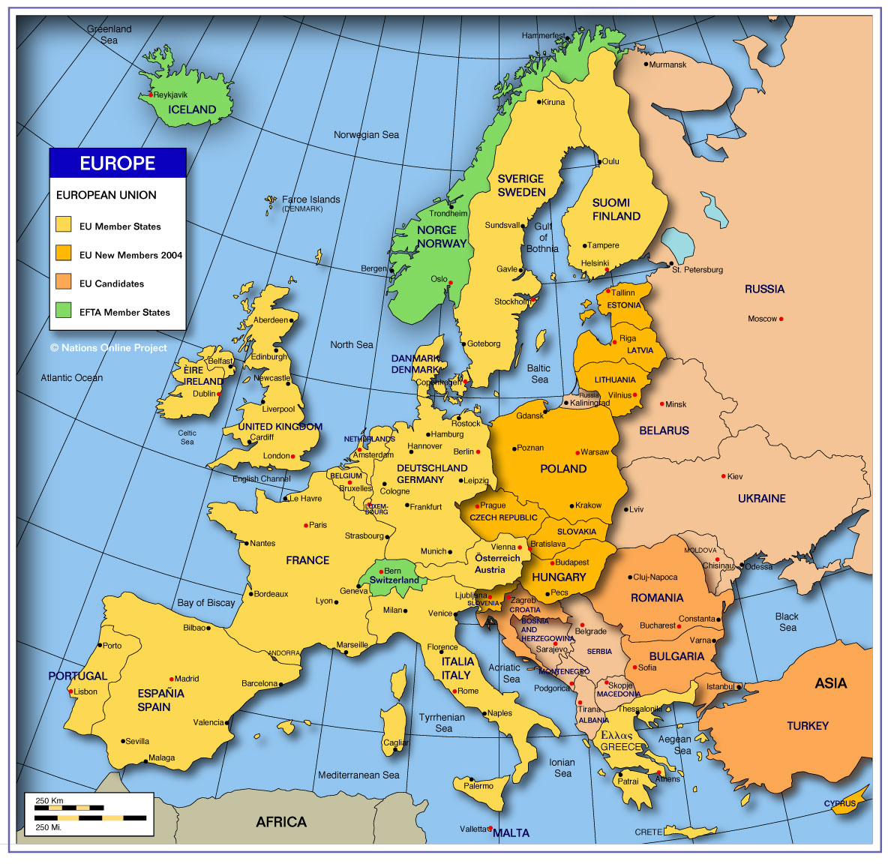
Map of Athens and Rome
Notes:
Have a student come to the board and

Slide 13
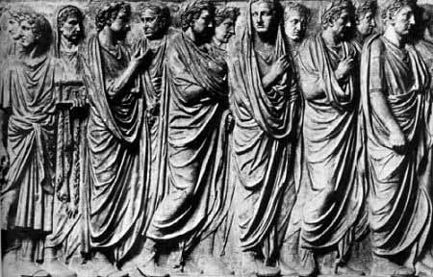
Roman Law
Romans created laws that their citizens had to follow
Laws were created by the republic
Roman laws were based on reason and justice and were designed to protect citizens and their property
Roman laws
No one should suffer penalty for what they think
The guilt or punishment of a father can impose no stigma upon the son
In inflicting penalties, the age of the guilty party must be considered

Slide 14
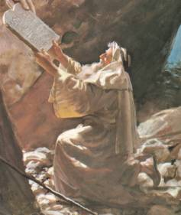
Judeo-Christian Tradition
Ancient Hebrews or Jews
First religion to believe in only one god
Hebrews believed that God gave all humans moral freedom
The ability to choose between good and evil
This belief led to a new emphasis on individual worth

Slide 15
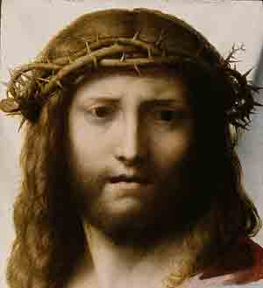
Judeo-Christian Tradition
Hebrews were openly against…
War
Oppression
Greed
Believed all people had the right to be treated with justice and dignity
In the 1st century a teacher came along – who do you think it was?

Slide 16
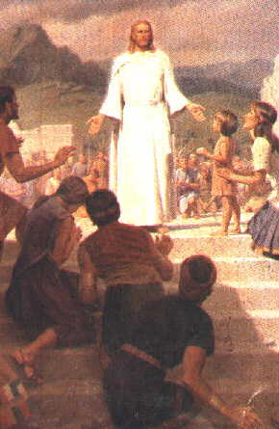
Judeo-Christian Tradition
Jesus adopted the views of the Hebrews
Christians spread their beliefs as opposed to the Jews who kept their beliefs to themselves
Christianity has helped shape democracy by preaching individual self worth

Slide 17
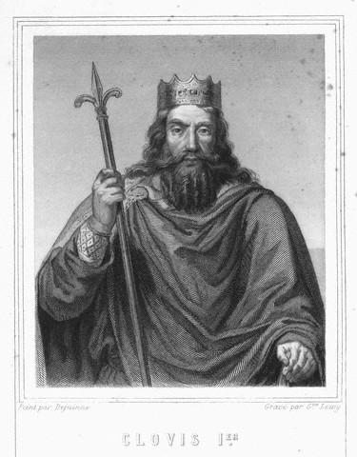
The Middle Ages
Early Middle Ages 500-1000 A.D.
After the fall of the Roman Empire, European focus shifted to the north
The Franks
Between 400 and 700 Germanic tribes carved up Europe
In 486 A.D. King Clovis converted the Franks to Christianity

Slide 18
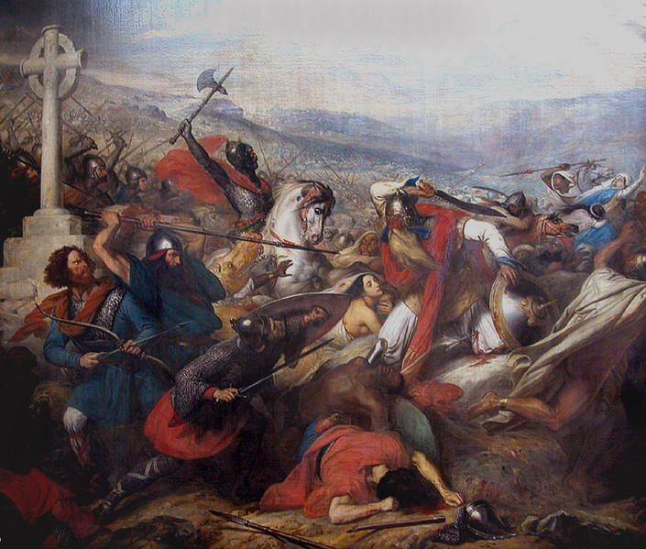
The Middle Ages
Europe and the Muslim World
The religion of Islam appears in Arabia in 622 A.D.
Muslim armies overran Christian territories in Palestine, North Africa and Spain
Muslims tried to overrun the Francs in France but lost
This made the Christians believe that God was on their side
Muslims were a source of anxiety for the Christians

Slide 19
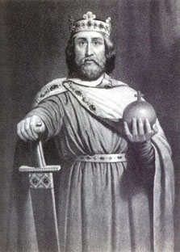
The Middle Ages
The Age of Charlemagne
Also known as Charles the Great
He loved battle and spent much of his reign battling the Muslims
He was a Christian Emperor
He was crowned by Pope Leo III as the Emperor of the Romans
Charlemagne tried to create a unified Christian Europe
He also created a revival of learning
Notes:
Revival of learning was geared to educate his people in many subjects including Latin. Before Charlemagne education was not a high priority and most of his clergy was very ignorant
Show clip of “she’s a witch”

Slide 20
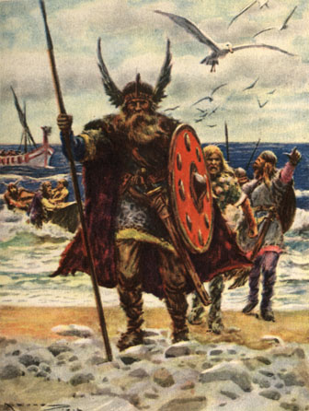
The Middle Ages
After Charlemagne
Charlemagne dies in 814
His empire soon fell apart
His heirs battled for power for 30 years
Treaty of Verdun was created and it split up Europe into 3 regions
Charlemagne’s heirs faced new waves of invasion from Muslims
The Vikings also snapped up a part of Charlemagne's empire
They were extremely destructive raiders

Slide 21
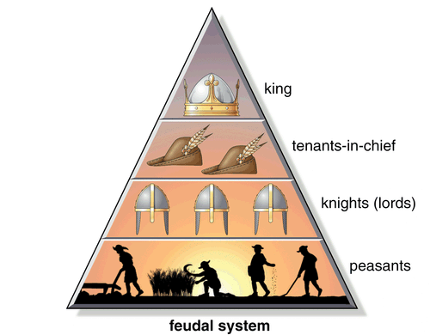
The Middle Ages
In the face of invasions by Vikings, Muslims and Magyars, kings and emperors were too weak to maintain law and order
In order to protect their homes, lands and themselves they developed a system known as Feudalism
Peasants and Lords agreed on a feudal contract
Tenants-in-chief gave lords a fief or estates
Fiefs came with Peasants to work the land
In exchange Lords promised to protect peasants

Slide 22
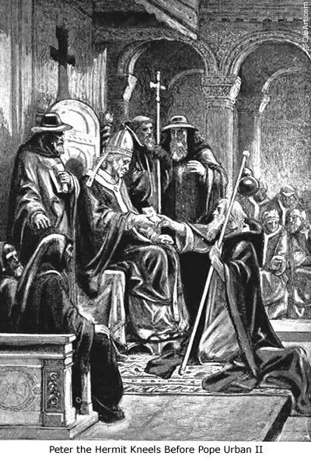
The Crusades
Pope Urban II
Calls for the first crusade in order to battle the Turks (Muslims)
By doing this he hoped that if his knights fought the Muslims they would stop fighting each other and it would unify Europe
1st Crusade 1096-1099
The only crusade to come close to achieving its goal
A long bloody campaign that resulting in Christian knights capturing Jerusalem in 1099
They then killed all Muslim and Jewish residents in the city
Notes:
Compare the crusades to the war in Iraq

Slide 23
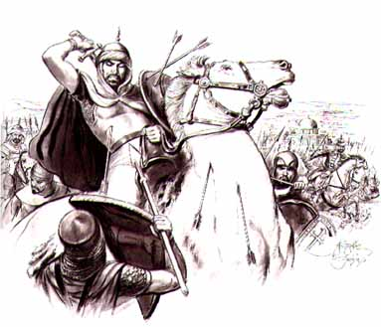
The Crusades
The Crusades lasted for 200 years
The 2nd Crusade 1147-1148
Muslims capture the city of Edessa
Bernard of Clairvaux calls for a new crusade against the Muslims
An unsuccessful crusade
The foolish attack of Damascus
The 3rd Crusade 1189-1192
Jerusalem recaptured by the Muslims and a leader by the name of Salah al-Din
Notes:
After negotiations Salah al-din reopened Jerusalem to Christian pilgrims
Also known as Saladin

Slide 24
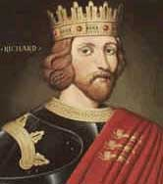
The Crusades
The 3rd Crusade
Pope Gregory VIII calls for the 3rd Crusade
Richard I of England joined this crusade
During this crusade the Christians believed that the Mediterranean would open up so they could walk to the holy land – It didn’t happen
Another failed crusade
Notes:
Richard the Lionheart

Slide 25
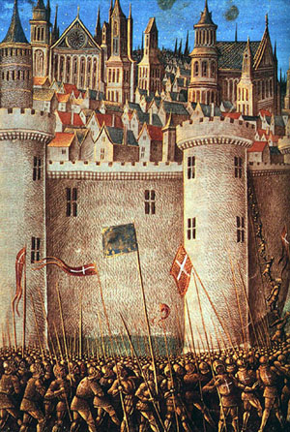
The Crusades
The 4th Crusade 1200-1204
Called for by Pope Innocent III
Tried to get to the holy land (Jerusalem) through Egypt
Made it to Constantinople where they were sacked (overrun) by the Muslims
The Children’s Crusade 1212
30,000 French children, 7,000 German children
Goal was to retake the holy land
All children were killed or sold into slavery

Slide 26
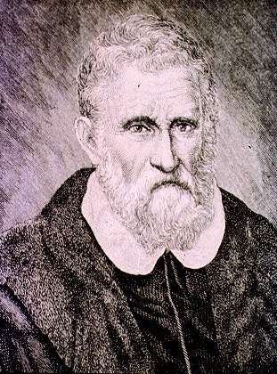
Effects of the Crusades
Left a bitter legacy of religious hatred
Both Christians and Muslims committed many atrocities
Economic Expansion
Increased Power of Monarchs
Churches power increases
Gave Christians a wider world view and the desire to explore Asia and India
Marco Polo – explored China and India and came back with many tales

Slide 27
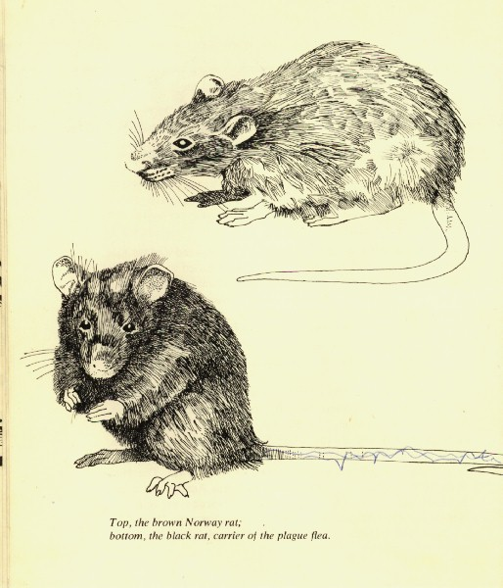
The Black Death
The Black Death Strikes
Kills 25 million people
Spread by fleas and unsanitary conditions
Divisions develop within the Catholic church
Many angry about the crusades and the black death
Beer saved the human population
Plymouth Rock
Notes:
Show Monty Python Bring out your dead clip

Slide 28
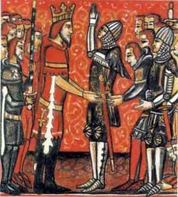
The Middle Ages
Peasants and Manor Life
Manor – the Lord’s estate
Serf – Peasant
Mutual Obligations
Serfs worked the land for the lords, repaired roads, bridges and fences
In return Lords gave serfs a few acres to use for themselves
Serfs were offered protection from Viking raids and feudal warfare
Serfs were not allowed to leave the manor
Notes:
Show Monty Python Feudalism clip

Slide 29
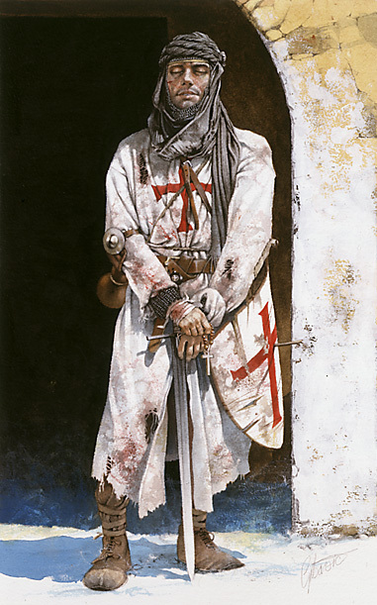
The Middle Ages
The World of Nobles
Many nobles trained from boyhood to become knights
In the 1100’s knights competed in tournaments
Powerful lords fortified their homes by creating castles around them
Castles often contained moats, draw bridges, towers and high walls

Slide 30
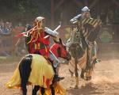
The Middle Ages
Chivalry - A code of conduct that knights followed
Knights were required to be brave, loyal and true to their word
In warfare they were required to fight fairly
Knights also treated women with great respect

Slide 31
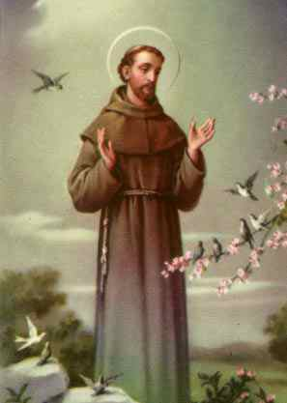
The Church and Medieval Life
The church converted most of Europe to Christianity
As representatives of Christ on earth, medieval popes eventually claimed Papal Supremacy or authority over all secular rulers
The Catholic church created their own laws
Canon law
Excommunication was the worst punishment

Slide 32
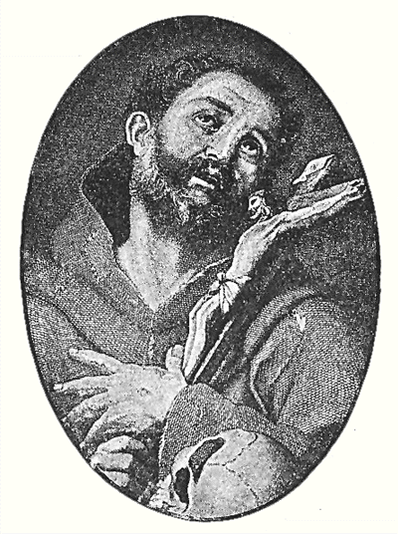
The Church and Medieval Life
The church called for the end of feudal fighting
Banned fighting from Friday to Sunday
The church had many successes
These successes led to weakened discipline within the church
Many called for reform
Notes:
Was it easy to reform the church if you could be excommunicated? No

Slide 33
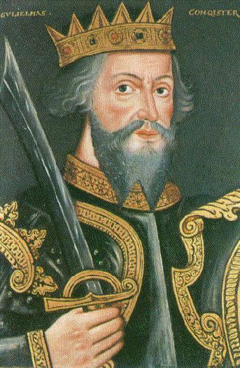
Growth of Royal Power in England and France
Monarchs began to undermine the power of feudal nobles
Monarchs began to create armies and taxes
Monarchs strengthen ties with the middle class therefore they had the support of the people
The church becomes the most powerful entity throughout Europe
Notes:
An army could help collect the taxes if necessary
Presidents and the middle class today

Slide 34
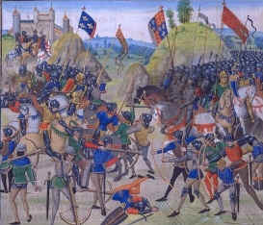
The Hundred Years War
1337 – 1453
Causes
England’s King Edward III tried to claim the French crown and French land
English Victories
At first England won many of the first battles thanks to the longbow – its range was far superior to that of a regular bow and arrow
England was very close to taking all of France over
French morale was very low

Slide 35
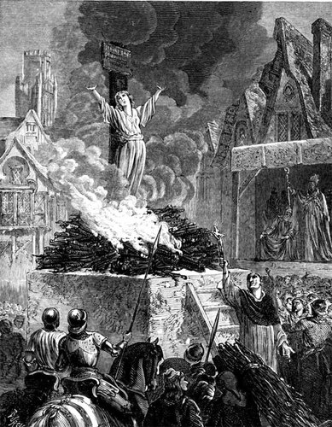
The Hundred Years War
Joan of Arc
1429 – A 17 year old peasant told the King of France Charles VII that God had chosen her to save France
She inspired the French and led them to many victories
She was taken captive by allies and turned over to the English
They tried her as a witch and burned her at the stake
This rallied the French and they went on the offensive
With their new invention, the cannon they drove the English out of France

Slide 36
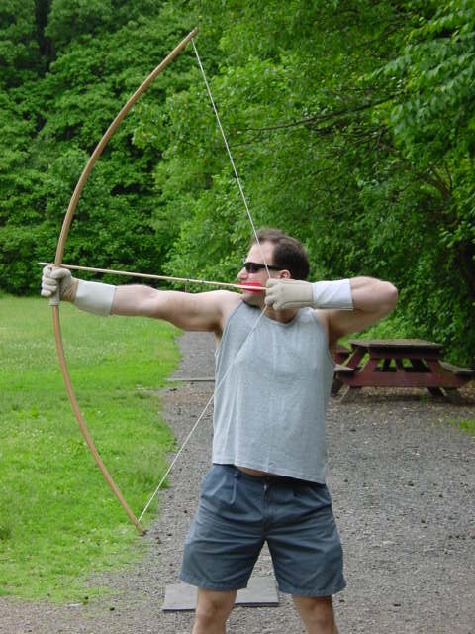
The Hundred Years War
Effects
England’s dream of a continental English empire was shattered
The victory allowed the French to spread their power
France felt a strong sense of national pride
The Longbow and Canon changed warfare
Monarchs now needed large armies to fight wars

Slide 37
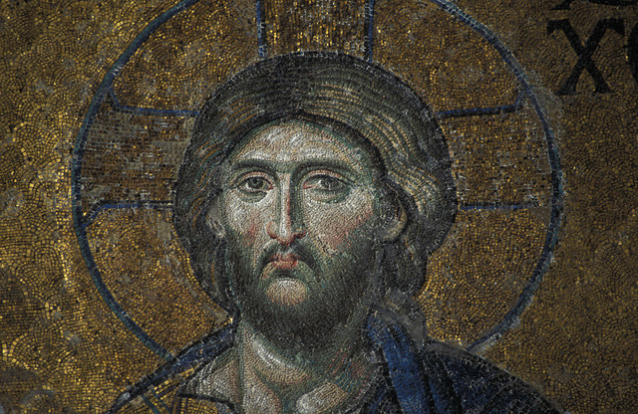
Babylonian Captivity
Upheaval in the church
The Black Death killed many members of the church
The replacements lacked strong leadership
1309 – Pope Clement V relocates the Papal court to Avignon (Southern France)
This is known as Babylonian Captivity
Pope lived lavishly
Notes:
Many question why God would choose to kill some members of the church but not others

Slide 38
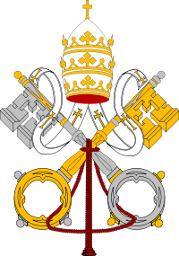
The Great Schism
Reformers elect their own Pope to rule from Rome
This lead to the Great Schism
The Catholic church splits
For many years there were two or three Popes all of which claimed to be the “True” Pope
1417 – The schism ends

